Slide 1


2024 HCA Single-Cell Omics in-person Computational and Experimental Design Workshop Clustering and Cell Annotation
June 24-28, 2024
Bangkok, Thailand

Slide 2
Computational track schedule
 | Beginner | Advanced
Monday | Preprocessing/QC | Data integration/cell type annotation/DE
Tuesday | Clustering/DE/data integration/cell type annotation | multi-omics/DA
Wednesday | TCR/BCR/CITE-Seq
Thursday | Trajectory inference/cell-cell communication
Friday | project/presentation

Slide 3
Module 2 – Clustering and cell annotation
2a. Dimensionality reduction + embeddings.
2b. Clustering.
2c. Marker genes and differential expression.
2d. Reference datasets and automated annotation.

Slide 4
Module 2 – cell annotation
2a. Dimensionality reduction + embeddings.
2b. Clustering.
2c. Marker genes and differential expression.
2d. Reference datasets and automated annotation.

Slide 5
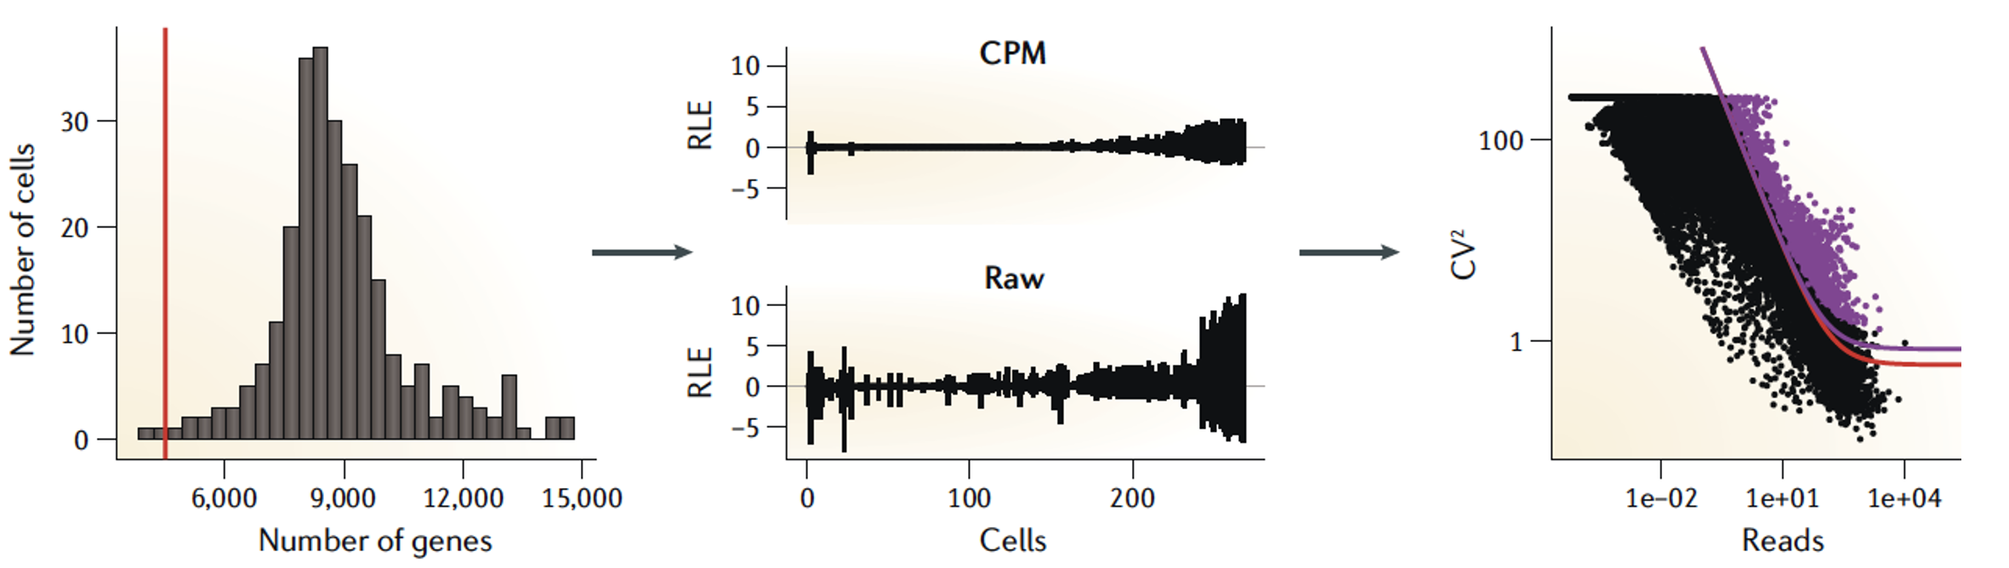
Determining cell type, state, and function
Quality control
Normalization
Feature selection
Dimensional reduction
Cell-cell distances
Unsupervised clustering
Kiselev C. at al. (2019) Nature Reviews Genetics. 20: 273-282.

Slide 6

Single-cell RNA-Seq analysis: feature selection
gene 2
Cells are in 20,000 dimensional space (one dimension for each gene), but hard to visualize!
gene 1
gene 3
Genes with highly variable expression contain biological signal related to cell states.
Many genes are lowly detected or noisy measurements.
We typically select 2,000-5,000 variable genes.
Be mindful when you work on dataset containing TCR/BCR or exogenous (e.g. viral or artificial constructs) transcripts
Notes:
Next we carry out feature selection, In this cartoon, cells are in 3D space with each cell localized based on its expression of genes 1,2,3. In reality cells are in 20K dimensional space (genes in human genome) but this is hard to visualize, and it is very difficult to cluster cells in higher-dimensional space. To reduce the dimensionality of the data, we only use those genes whose expression levels are highly variable across individual cells. The intuition is that a gene that has the same expression across all cells will not distinguish different T cell states, while genes that are high in one state and low in another state are informative. This is the feature selection. We typically select 2000-5000 most highly variable genes.

Slide 7
Single-cell RNA-Seq analysis: feature selection
CV (counts)
Mean counts
Find genes (features) that are outliers in a plot of mean of gene expression vs variance of gene expression

Slide 8
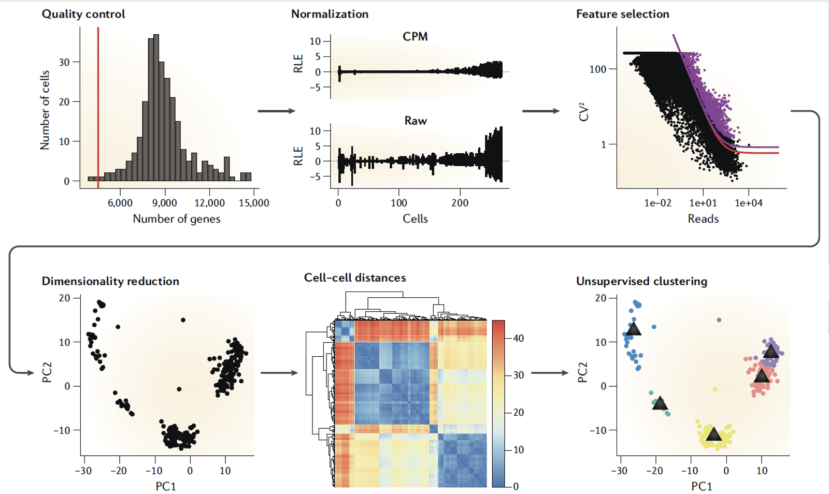
Determining cell type, state, and function
Quality control
Normalization
Feature selection
Dimensional reduction
Cell-cell distances
Unsupervised clustering
Kiselev C. at al. (2019) Nature Reviews Genetics. 20: 273-282.

Slide 9
Dimensionality reduction
Cells are in ~20,000 dimensional space
many genes are lowly detected / noisy measurements
genes are not independent of one another! rather they operate in coregulatory modules
curse of dimensionality
Principle component analysis moves us from describing cells with 20,000 gene expression values to 10-100 principal component scores

Slide 10
Dimensionality reduction
One approach to simplification is to assume that the data of interest lies within lower-dimensional space. If the data of interest is of low enough dimension, the data can be visualised in the low-dimensional space.
Common Techniques
Principal Component Analysis (PCA)
Independent Component Analysis (ICA)
Multidimensional Scaling (MDS)
Non-negative Matrix Factorization (NMF)
Probabilistic Modeling (e.g. Latent Dirichlet Allocation - LDA)

Slide 11
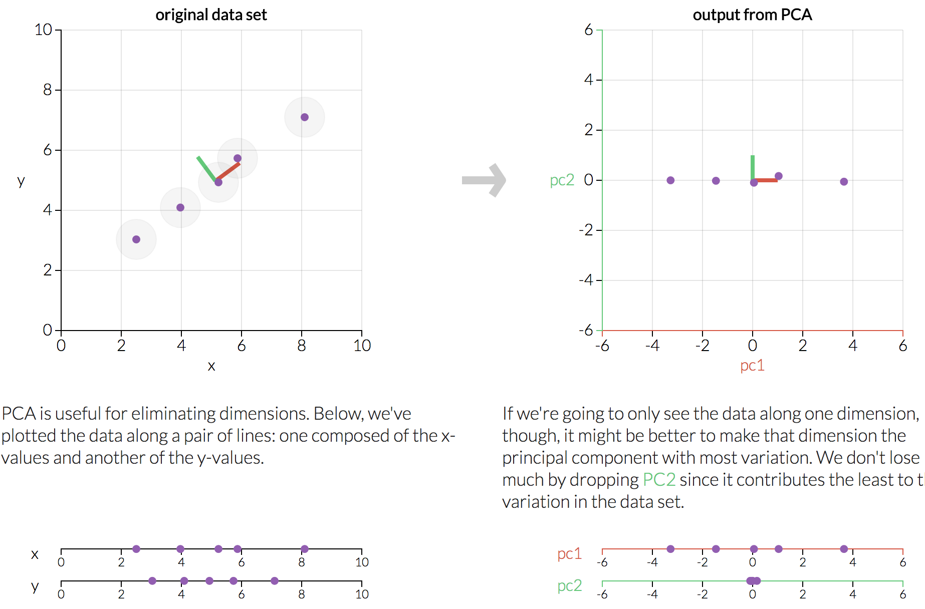
Dimensionality reduction
http://setosa.io/ev/principal-component-analysis/

Slide 12

Dimensionality reduction
PCA is a dimensionality reduction method that transforms a set of features into a set of linearly uncorrelated variables called principal components
The first principal component contains the most variance, and each component after contains as much variance while still being orthogonal to other components
https://stats.stackexchange.com/questions/2691/making-sense-of-principal-component-analysis-eigenvectors-eigenvalues

Slide 13
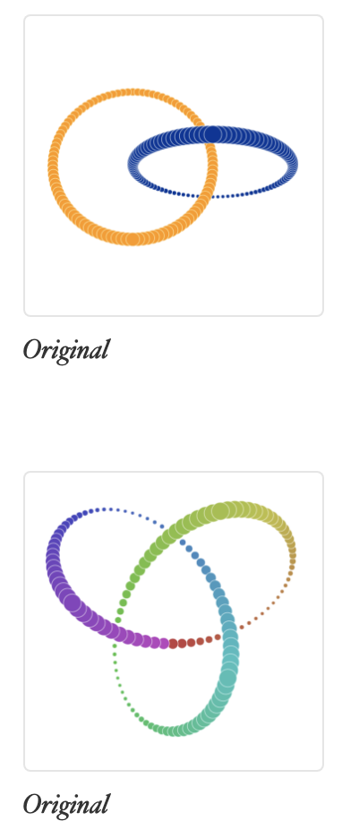
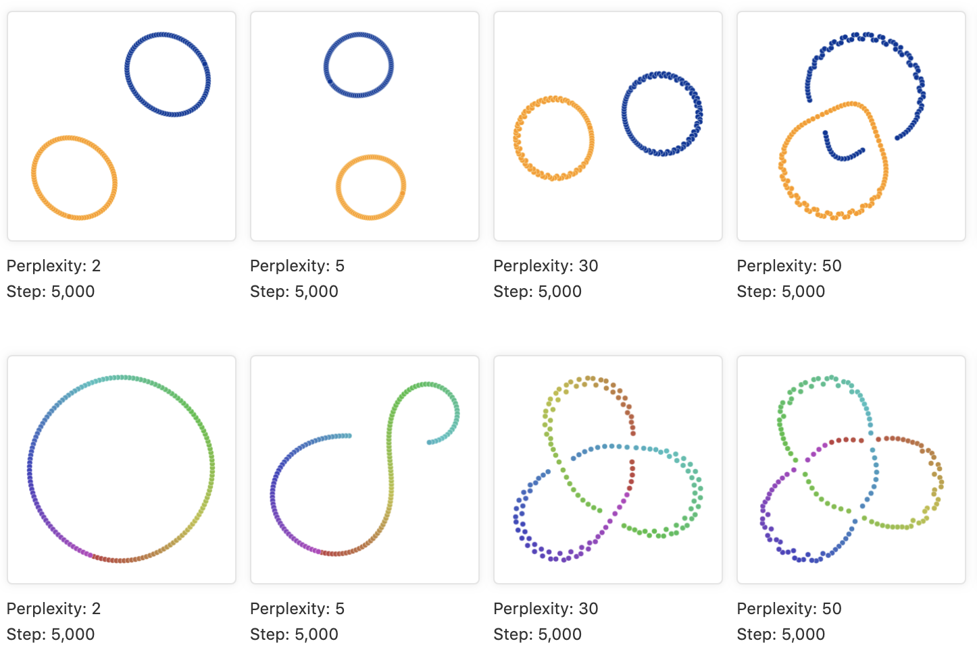
Representing local neighborhoods
High dimension manifold
Low dimension representation
Place cells with similar local neighborhoods in high-dimension space together in low-dimension space.
t-SNE and UMAP are popular visualizations.
https://distill.pub/2016/misread-tsne
https://pair-code.github.io/understanding-umap/
Notes:
Local accuracy vs global accuracy in representation
In order to construct the initial high-dimensional graph, UMAP builds something called a "fuzzy simplicial complex". This is really just a representation of a weighted graph, with edge weights representing the likelihood that two points are connected. To determine connectedness, UMAP extends a radius outwards from each point, connecting points when those radii overlap. Choosing this radius is critical - too small a choice will lead to small, isolated clusters, while too large a choice will connect everything together. UMAP overcomes this challenge by choosing a radius locally, based on the distance to each point's nth nearest neighbor. UMAP then makes the graph "fuzzy" by decreasing the likelihood of connection as the radius grows. Finally, by stipulating that each point must be connected to at least its closest neighbor, UMAP ensures that local structure is preserved in balance with global structure.

Slide 14
Module 2 – cell annotation
2a. Dimensionality reduction + embeddings.
2b. Clustering.
2c. Marker genes and differential expression.
2d. Reference datasets and automated annotation.

Slide 15
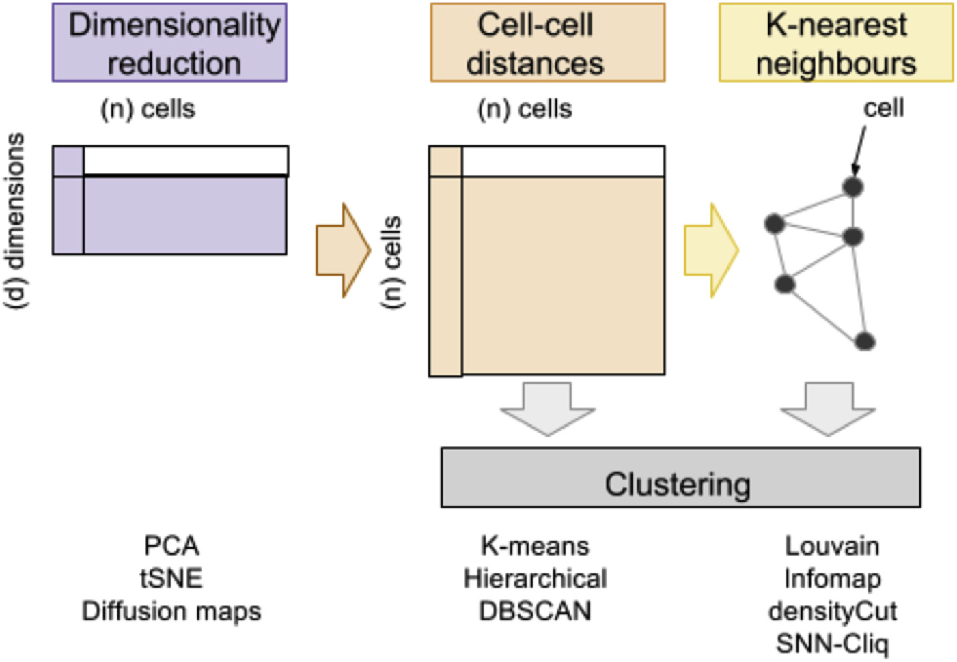
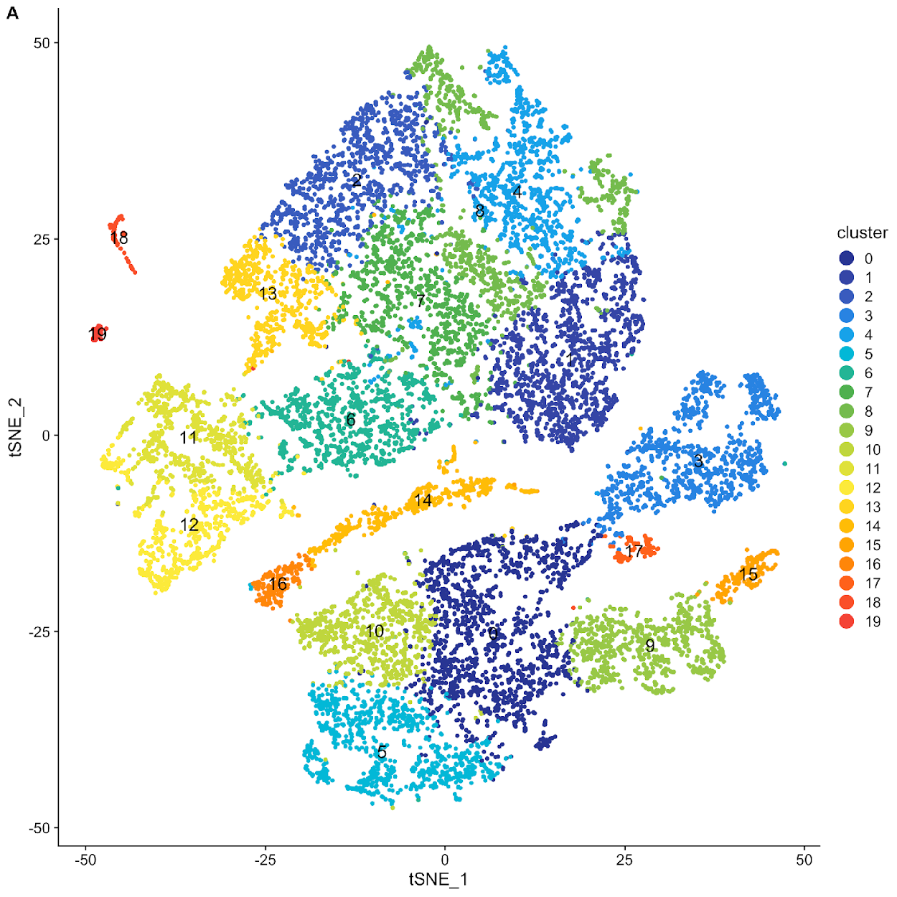
Clustering in KNN graphs
Andrews, Tallulah S. at al. (2017) Molecular aspects of medicine.

Slide 16


KNN graph

Slide 17
KNN graph
1

Slide 18
KNN graph
1
2

Slide 19
KNN graph
1
3
2

Slide 20
KNN graph
4
1
3
2

Slide 21
KNN graph
4
1
3
2
4
1
3
2

Slide 22
KNN graph

Slide 23
Single-cell RNA-Seq analysis: Clustering principal components

Slide 24
Single-cell RNA-Seq analysis: Clustering principal components
Two cells are connected by an edge if any of their nearest neighbors are shared.

Slide 25
Clustering in KNN graph

Slide 26
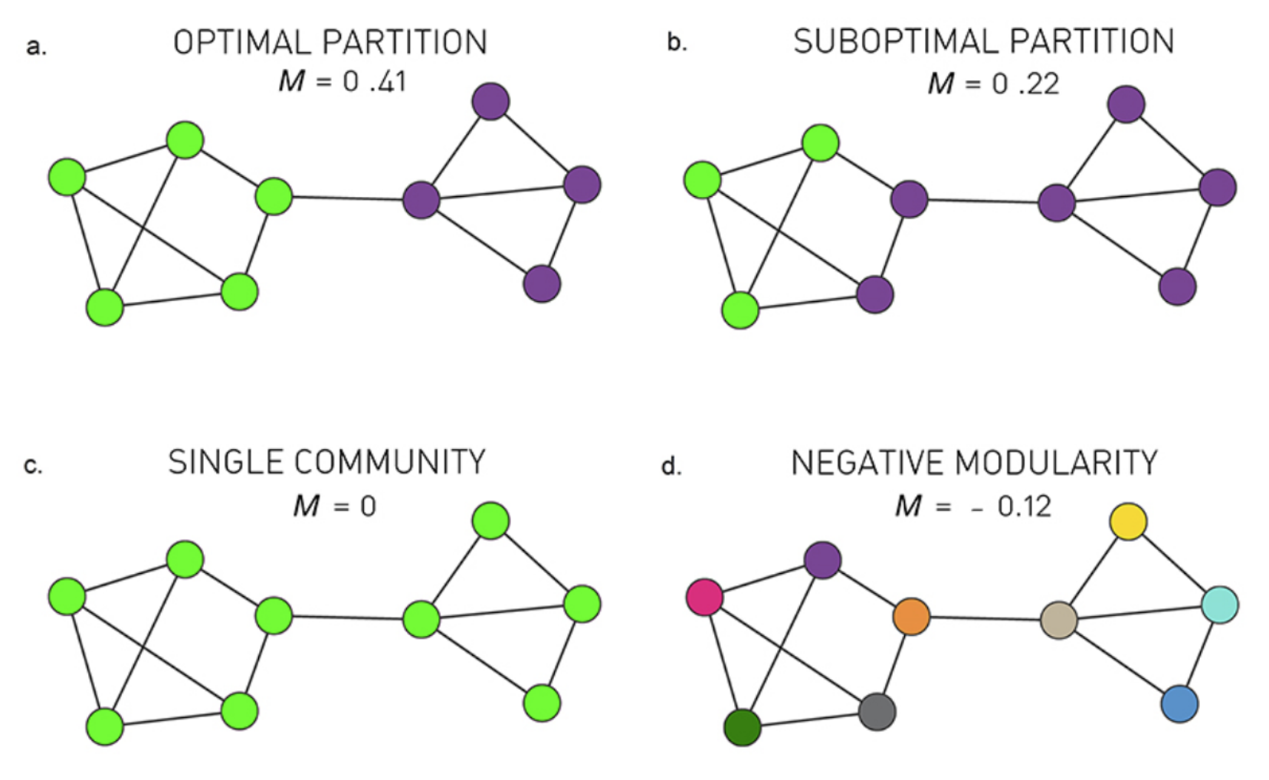
Clustering in KNN graph
Graph-based clustering is based on community detection.
Many different algorithms for community detection:
Louvain (heuristic), Infomap, Walktrap
Most of them are based on modularity maximization

Slide 27
Module 2 – cell annotation
2a. Dimensionality reduction + embeddings.
2b. Clustering.
2c. Marker genes and differential expression.
2d. Reference datasets and automated annotation.

Slide 28
Comparing gene expression distributions
In scRNA-Seq we often do not have a defined set of experimental conditions.
Instead, we can perform pairwise comparisons of gene expression, between pairs of cell clusters, using some of the following tests:
Wilcoxon rank sum test
Student’s t-test
Wald test in a generalized linear models – depend on a choice of distribution: poisson or negative binomial underlying negative binomial distribution. Use only for UMI-based datasets
Others…

Slide 29
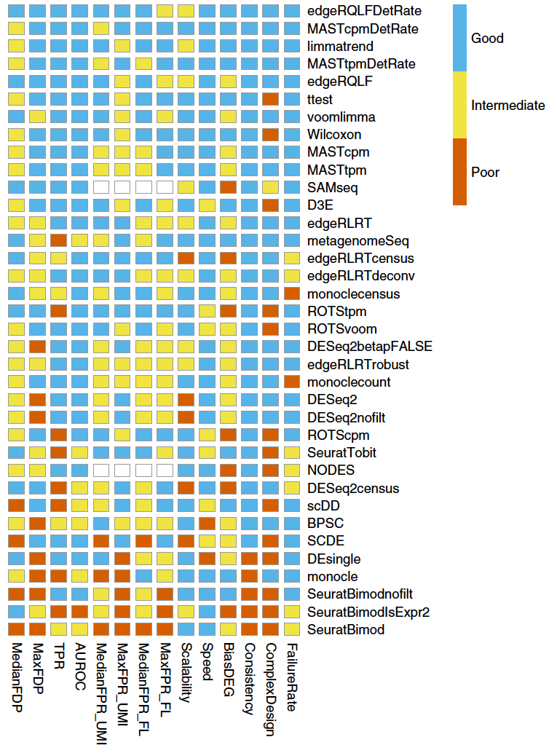
Differential expression analyses
There are many ways to test for differential expression!
It is difficult to establish a ground truth for differential expression in scRNA-seq data. Therefore, benchmarking is difficult.
Soneson C. at al. (2018) Nature Methods. 15: 255-261.

Slide 30
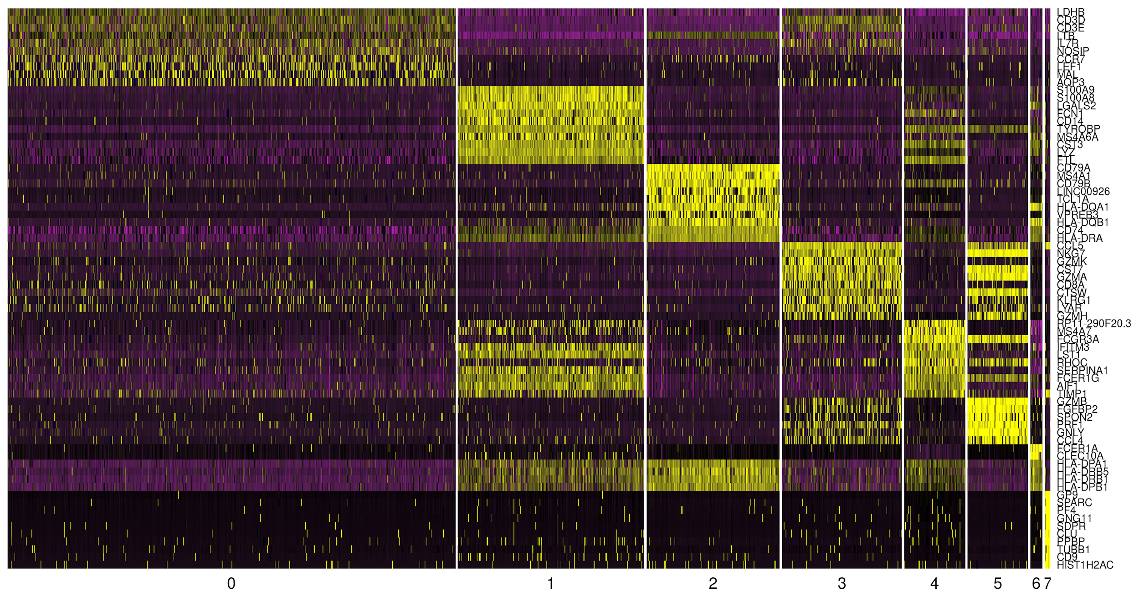
Differential expression analyses
Genes
Cell clusters

Slide 31
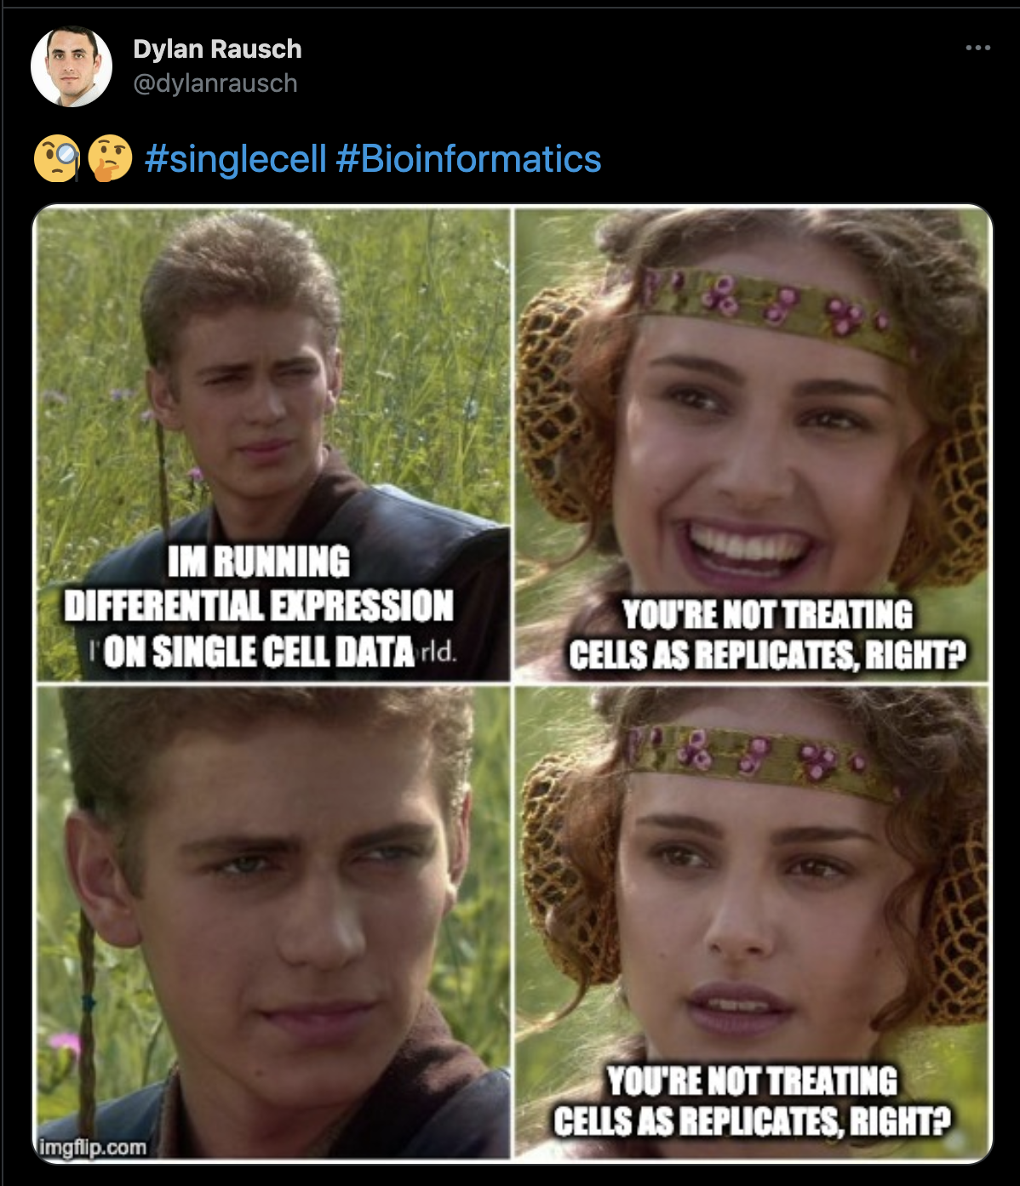
Differentially expressed genes across biological conditions
When detecting gene differentially expressed across different biological conditions (e.g. case vs control, treated vs untreated, etc…), what is the replicate? A single cell? A sample?
Treating a single cell as a replicate will lead to false discoveries so treat p-values with care. Consider using pseudobulk models or mixed effect models when comparing samples across conditions as an alternative.
Crowell, Helena L., et al. "Muscat detects subpopulation-specific state transitions from multi-sample multi-condition single-cell transcriptomics data." Nature communications (2020).
Squair, Jordan W., et al. "Confronting false discoveries in single-cell differential expression." Nature communications (2021).
https://www.nxn.se/valent/2019/2/15/handling-confounded-samples-for-differential-expression-in-scrna-seq-experiments

Slide 32
Determining cell type, state, and function: Recap
Quality control
Normalization
Feature selection
Dimensional reduction
Cell-cell distances
Unsupervised clustering
Kiselev C. at al. (2019) Nature Reviews Genetics. 20: 273-282.

Slide 33
Module 2 – cell annotation
2a. Dimensionality reduction + embeddings.
2b. Clustering.
2c. Marker genes and differential expression.
2d. Reference datasets and automated annotation.

Slide 34
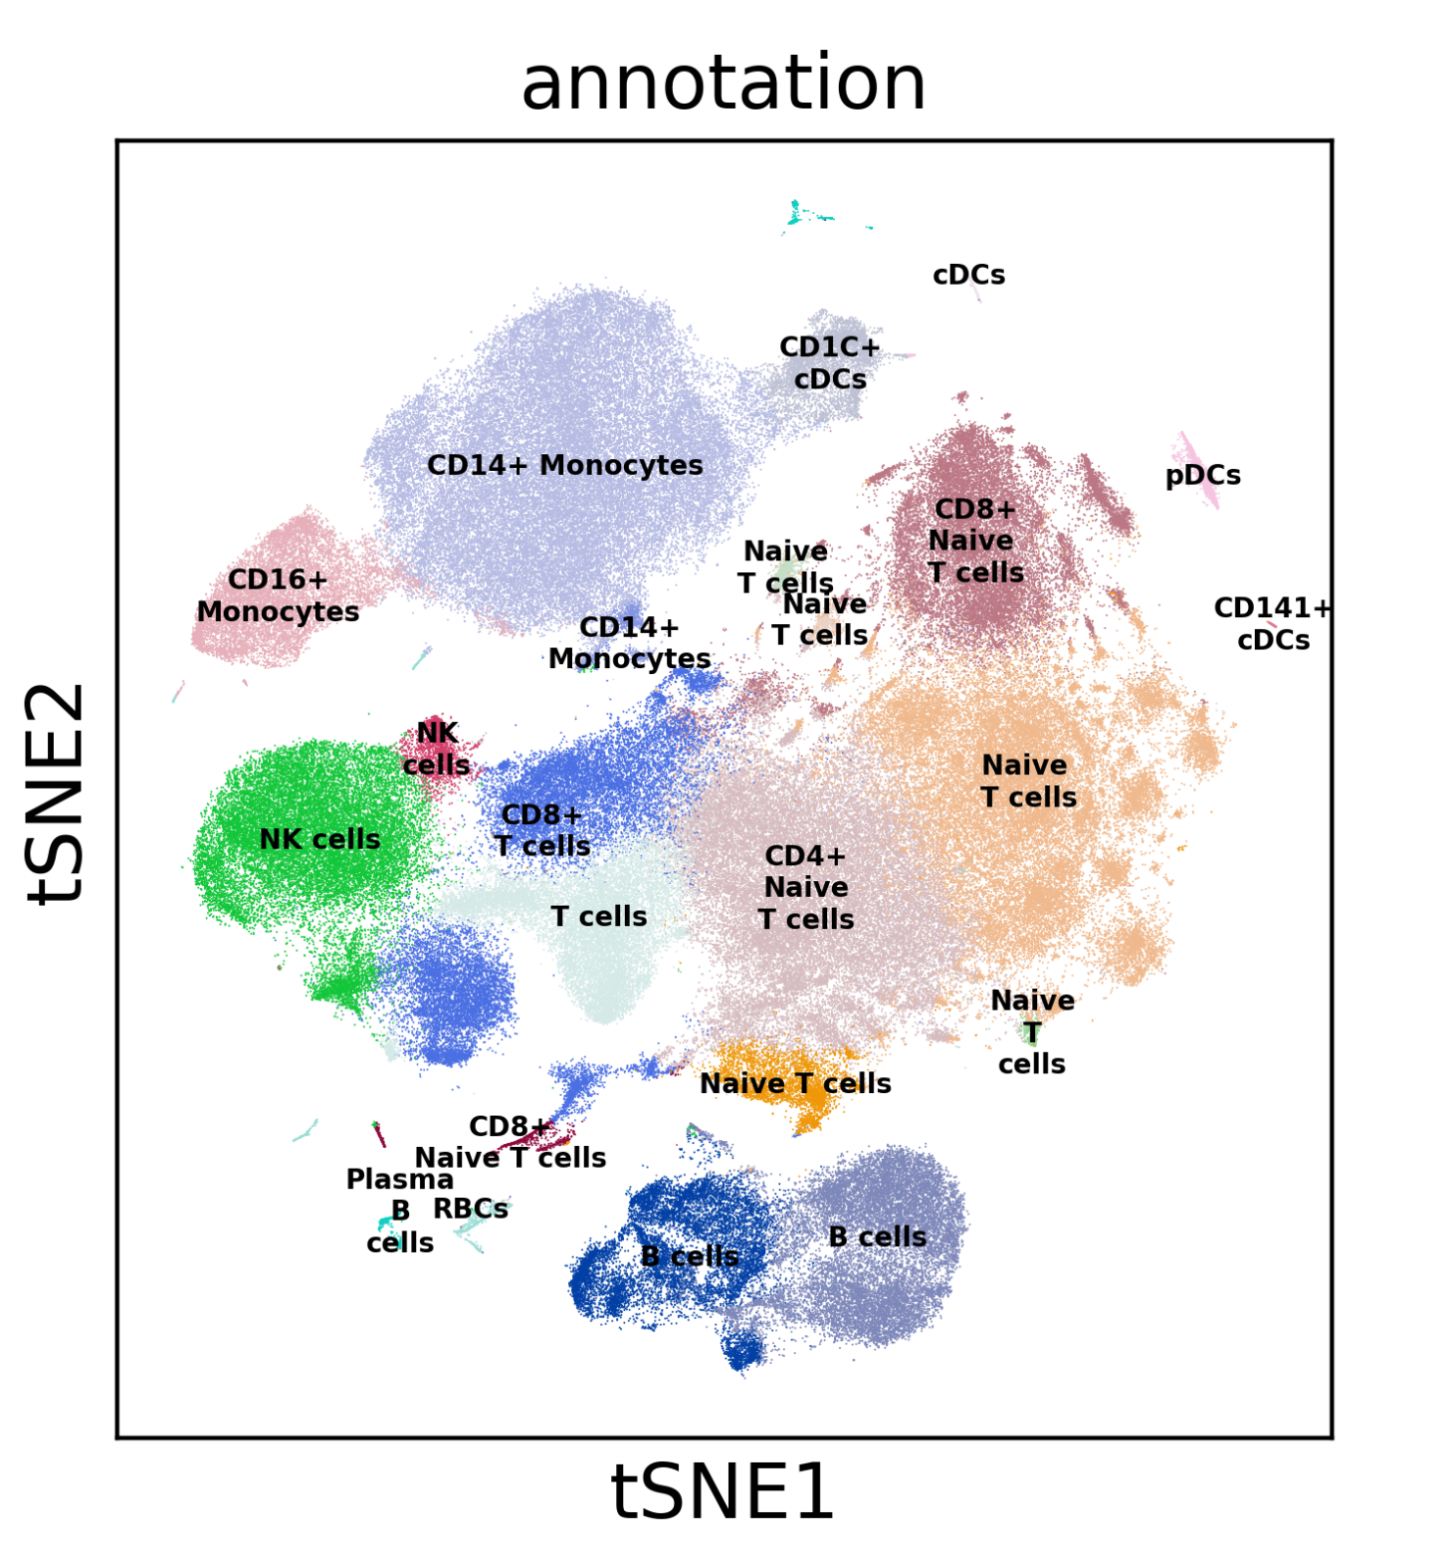
Single-cell RNA-Seq analysis: Cell state annotation
500K immune cells collected from healthy humans.
Immune cells are colored by their cluster identity and visualized in a tSNE embedding.
Cell types are identified by inspecting genes differentially expressed in one cluster relative to other clusters.

Slide 35
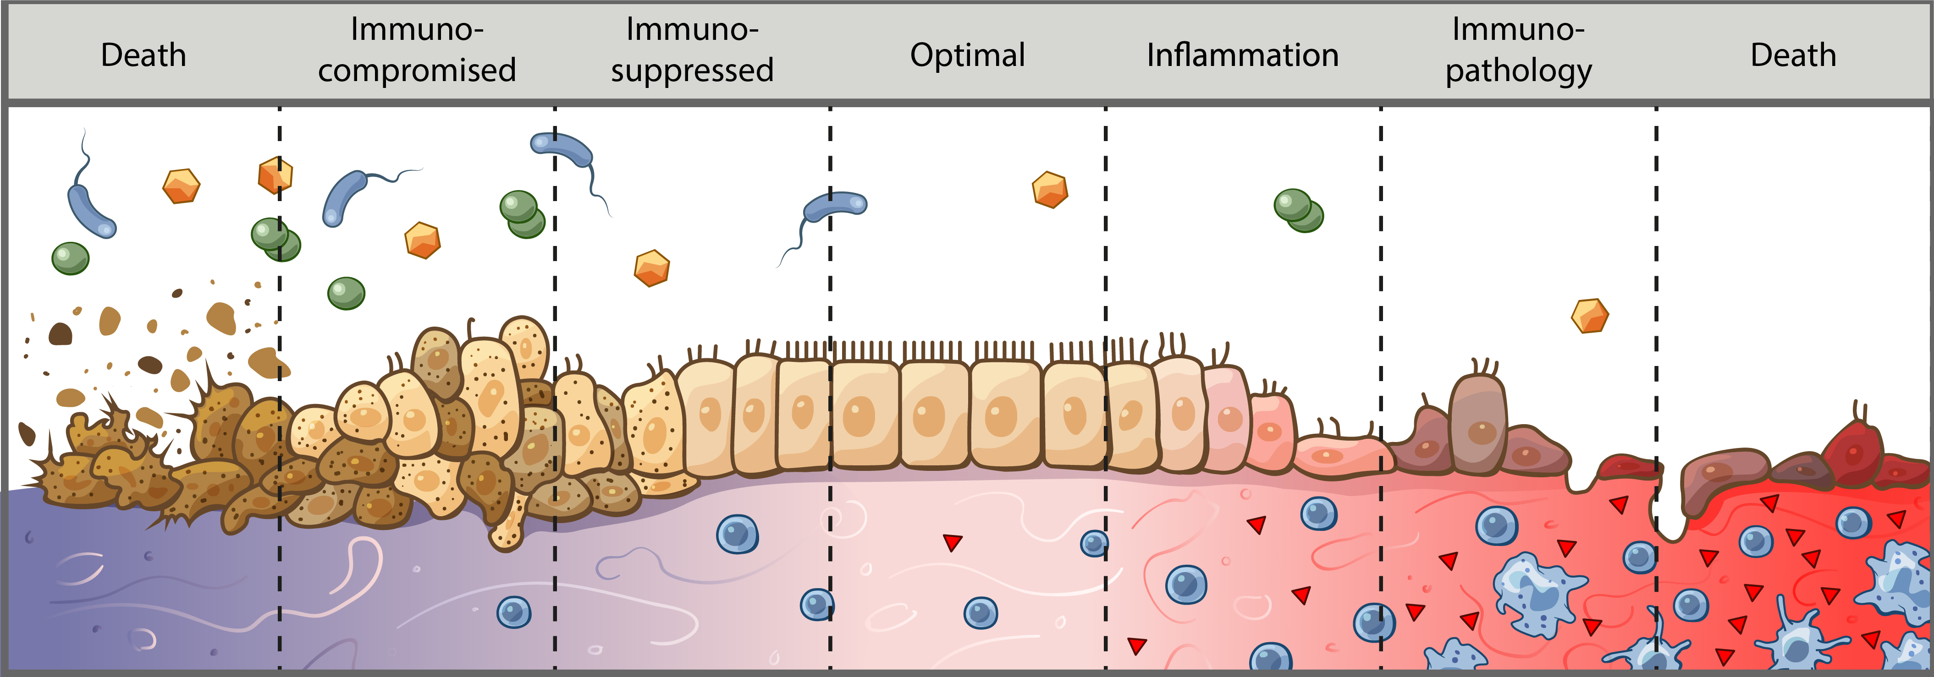
What are we actually annotating?
Cells exist along multiple continuums
Ex. Differentiation, inflammatory response, anti-viral response, EMT transition
Conventional profiling techniques puts cells into “buckets”
Unbiased approaches allows us to appreciate how cell types/states relate to each other along a spectrum
We have a hard time conceptualizing this spectrum—so we need to annotate cells similarly to conventional techniques
Usually with a bit more nuance in determining cell states

Slide 36
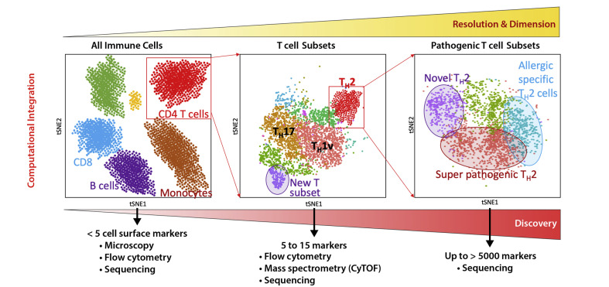
Biology to your data!
Annotating cells in single-cell gene expression data is a challenge!
-What’s a cell type?
Gene expression is not discrete but mostly a continuum
Gene expression ≠ cellular function
-Resolution
Subsets
Phenotypes
Differentiation
Seumois G, Vijayanand P 2019 . J Allergy Clin Immunol.

Slide 37
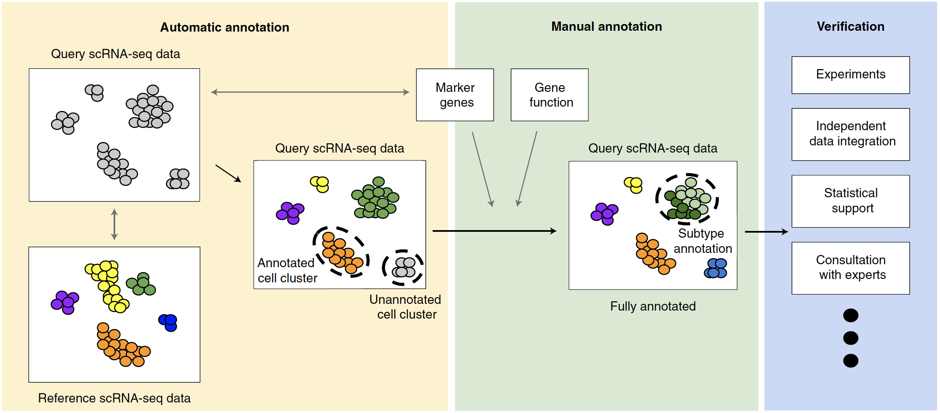
How to identify the cell types of clustered cells?
Clarke, Z. A. at al. (2021) Nature Protocols. 16: 2749-2764.
Abdelaal, T. et al., (2019) Genome Biology. 20:194.

Slide 38
Approach 1: De novo cluster annotation
Three main approaches to assigning clusters
Annotating based on known marker genes
Annotating on differential gene expression
Annotating on previously reported module scoring
Edge cases
Doublets
Low-quality cells
Host-pathogen annotations
Clustering accuracy
Over-clustering
Under-clustering
Iterative clustering

Slide 39
Annotating based on known marker genes
Requires understanding of expected cell types and their markers
Biological expertise here is critical
Many protein and RNA markers overlap
However, not all protein markers translate well into RNA space
Experience with cell types in sample and scRNA-seq will help identify which protein markers do or do not translate to RNA space
Most useful for identifying coarse cell types and some cell states, but difficult to annotate pathological cell states in disease

Slide 40
Annotating on differential gene expression
Begin with one-against-all differential gene expression
Easier to annotate based on upregulated rather than downregulated genes
Known marker genes that are highly expressed should show up here
May not depending on differential gene expression cutoffs
Top 20 to 30 genes should give an indication of the cell states as well as cell type
Ex. Inflammatory, anti-viral, low-quality, etc.

Slide 41
Annotating on differential gene expression (cont’d)
This is an iterative process
You should not expect to be able to confidently identify all your cell clusters on your first pass
There will likely be clusters that are very similar to each other
Run differential gene expression between those similar clusters ONLY to figure out what’s different between them
If differential gene expression doesn’t make sense biologically, combine clusters into one
Continue to iterate and re-check work as you go

Slide 42
Annotating on previously reported module scoring
Supplementary tables will usually list differential gene expression used for assigning clusters in other studies
Use these to your advantage
Great for checking work
Make sure species and system are correct
Technology used may influence results
These basic techniques should not be used in a vacuum—they build on each other to convince you that you have annotated your clusters correctly

Slide 43
Approach 2: Databases and Reference atlases
Marker genes and databases
Literature
Tissue and protein DB
Single-cell atlases
Automated tools
Correlation-based
Supervised classification

Slide 44

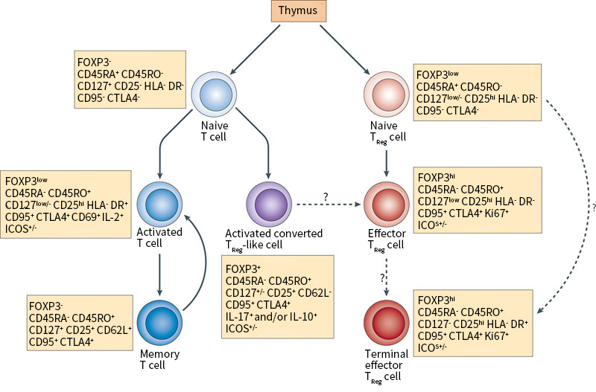
Approach 2: Marker genes and databases
Literature!
Single-cell RNAseq is a new field but cell types are not!
Book knowledge is important, know your model!
Rely on experts and collaborators

Slide 45
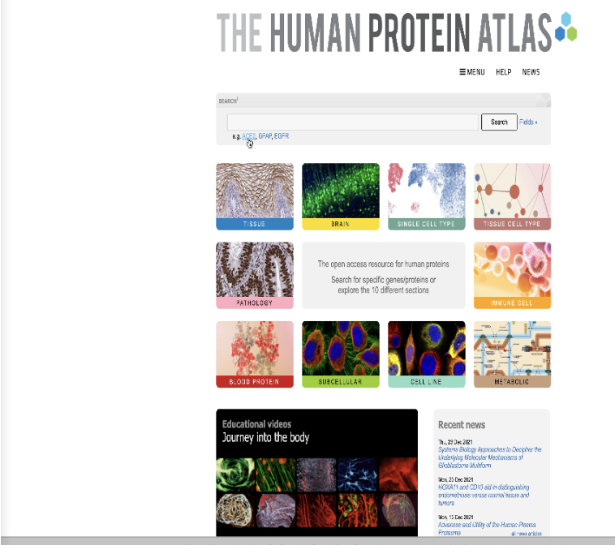
Approach 2: Marker genes and databases
Tissue and protein DB
Protein cell atlas - > https://www.proteinatlas.org/
Immunological Genome Project - > https://www.immgen.org/
GTEx (Genotype-Tissue Expression) -> https://gtexportal.org/home/

Slide 46
Approach 2: Marker genes and databases
Other organism
Mouse https://www.emouseatlas.org
Fly https://flybase.org/
C. elegans https://www.wormatlas.org/
Zebra fish https://bio-atlas.psu.edu/zf/
NCBI
https://www.ncbi.nlm.nih.gov/
The European Bioinformatics Institute (EMBL- EBI)
https://www.ebi.ac.uk/services

Slide 47
Approach 2: Single-cell atlases
Single-cell DB for manual annotation
Meaning you have your set of genes and search for them one by one in these DB
Human cell atlas (HCA) https://www.ebi.ac.uk/humancellatlas/project-catalogue/
Tabula murris (Mouse atlas)
Broad institute Single-cell portal https://singlecell.broadinstitute.org/
PanglaoDB https://panglaodb.se/
CellMarker http://biocc.hrbmu.edu.cn/CellMarker/index.jsp

Slide 48
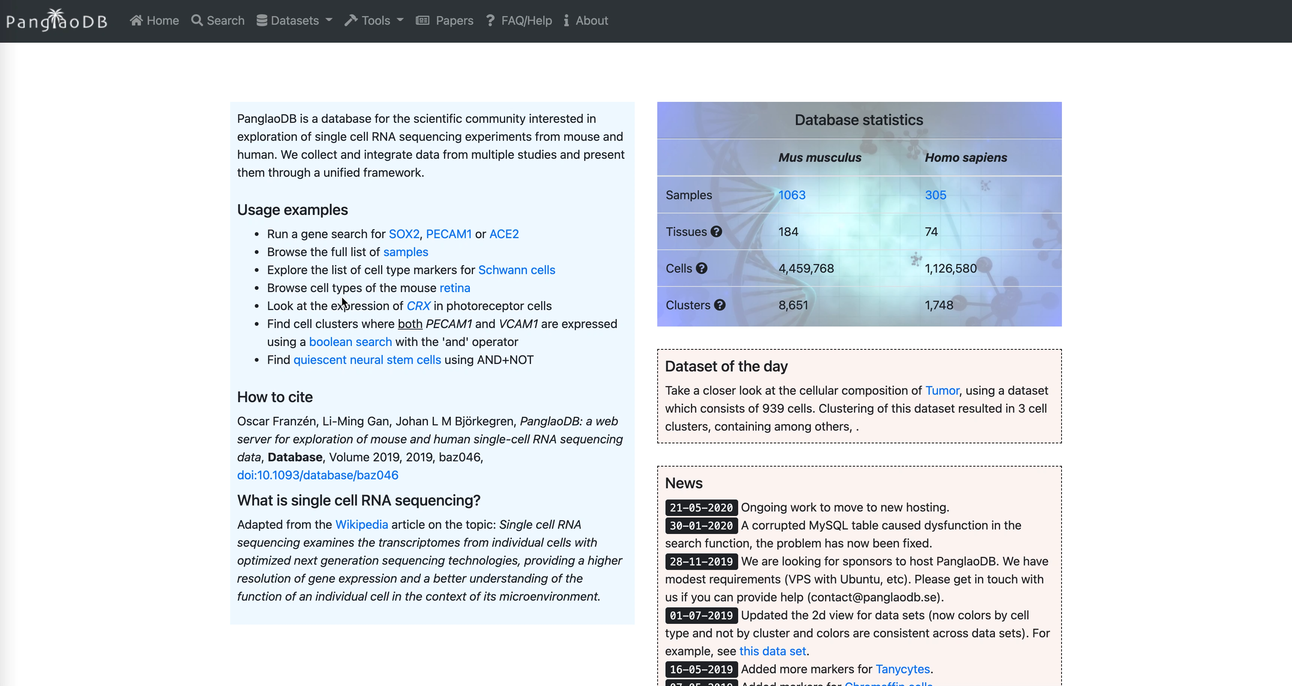
Approach 2: Single-cell atlases
Single-cell DB for manual annotation
PanglaoDB https://panglaodb.se/

Slide 49
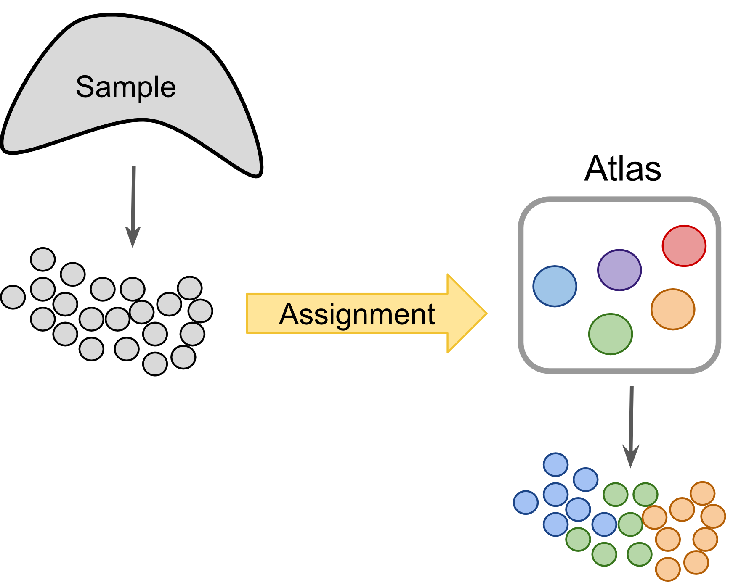
Approach 2: Automated tools
Project cells or clusters from a new sample onto a reference (Cell Atlas or previous study) to identify cells with novel/unknown identity ----> Cell type like BLAST method
IMPORTANT: A reference cell type information is needed
Can be done intra-species
Different-omics!
Different approaches
Correlation-based
Supervised classification
https://www.singlecellcourse.org/

Slide 50
Approach 2: Automated tools
Approach | Tool name | Language | Computational approach
Correlation-based | scmap-cluster | R, web app | Cosine, Spearman, Pearson
 | scmap-cell | R, web app | Cosine distance based kNN
 | SingleR | R | Spearman
 | CHETAH | R, Shiny app | Spearman + confidence
 | scMatch | Python | Spearman, Pearson
 | ClustifyR | R | Spearman, Pearson, Kendall, cosine
 | CIPR | R, Shiny app | Dot product, Spearman, Pearson
Supervised classification-based | CaSTLe | R | XGBoost classifier
 | Moana | Python | kNN-smoothing + SVM
 | LAmbDA | Python | Multiple ML techniques
 | superCT | Web app | Artificial Neural Network
 | SingleCellNet | R | Random Forest
 | Garnett | R | Elastic net regression
 | scPred | R | SVM
 | ACTINN | Python | Artificial Neural Network
 | OnClass | Python | kNN and Bilinear Neural Network
 | scClassify | R, Shiny app | Weighted kNN classifier
 | scArches | Python | Autoencoder
Pasquini et al, 2021, Computational and Structural Biotechnology Journal

Slide 51
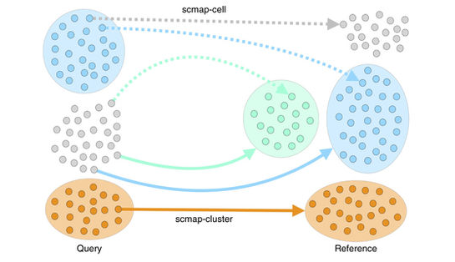

Approach 2: Automated tools
The search can be done by cluster or by cell , in each cluster/cell by its centroid (a vector of the median value of the expression of each gene) and measure the similarity between c and each cluster centroid or cell in the refence is calculated and ranked
Pasquini et al, 2021, Computational and Structural Biotechnology Journal

Slide 52
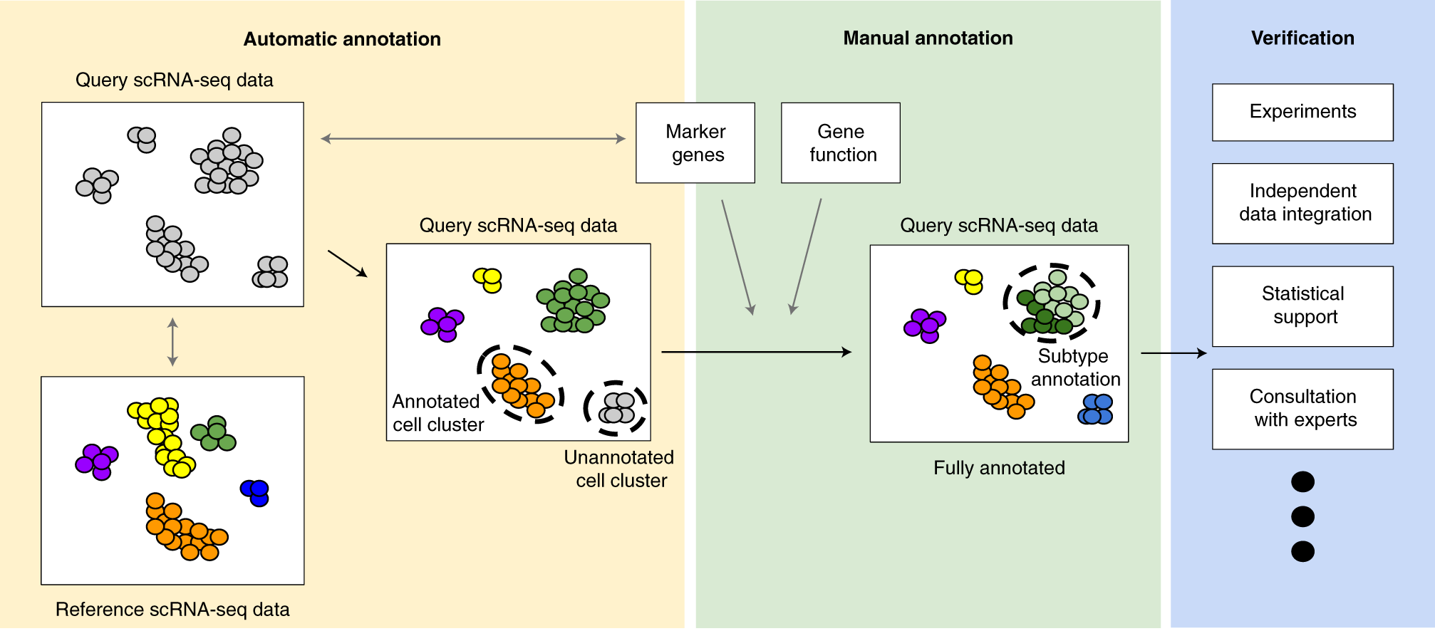
Recent helpful articles on data integration methods
An ideal cluster/cell type annotation process is composed of three major steps: automatic cell annotation, manual cell annotation and verification
Clarke, Z.A., Andrews, T.S., Atif, J. et al Nat Protoc 16, 2749–2764 (2021).

Slide 53
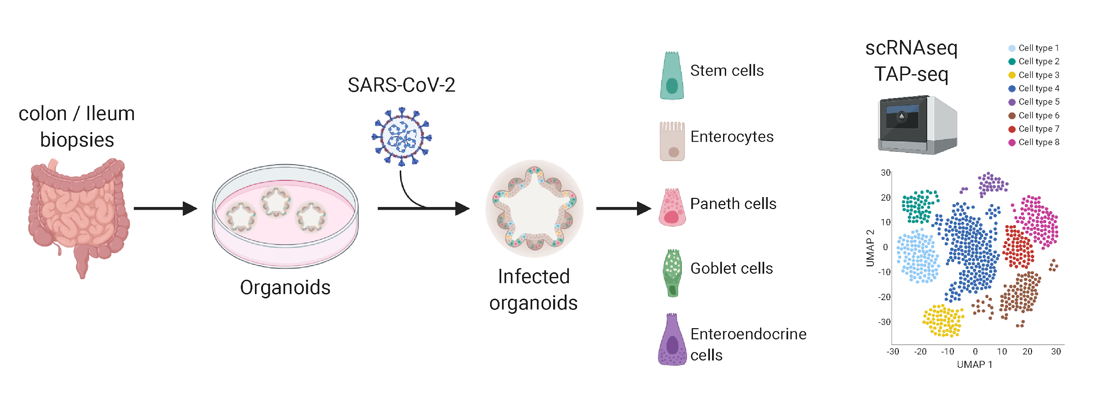
Example

Slide 54
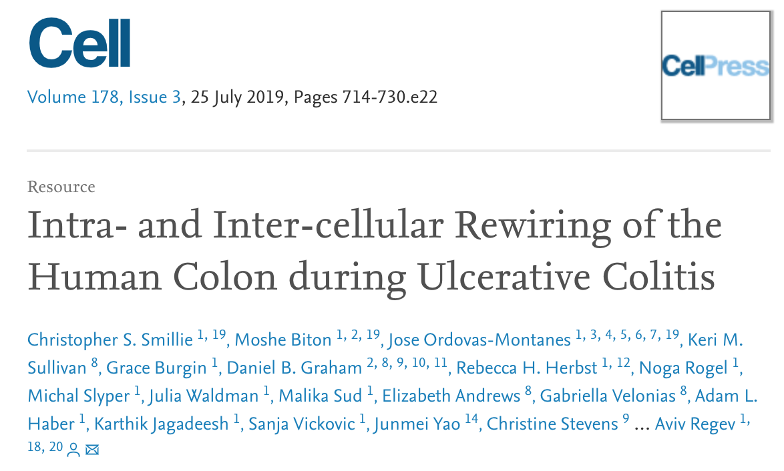
Example
366.650 cells from human colon mucosa

Slide 55
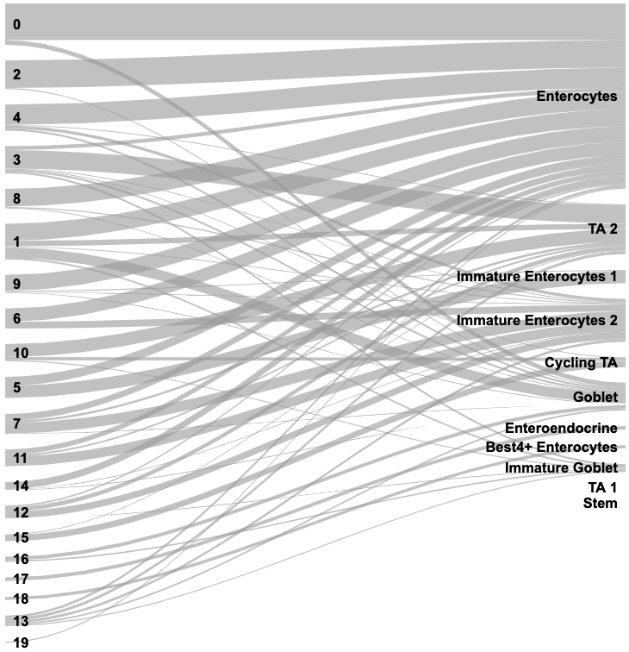
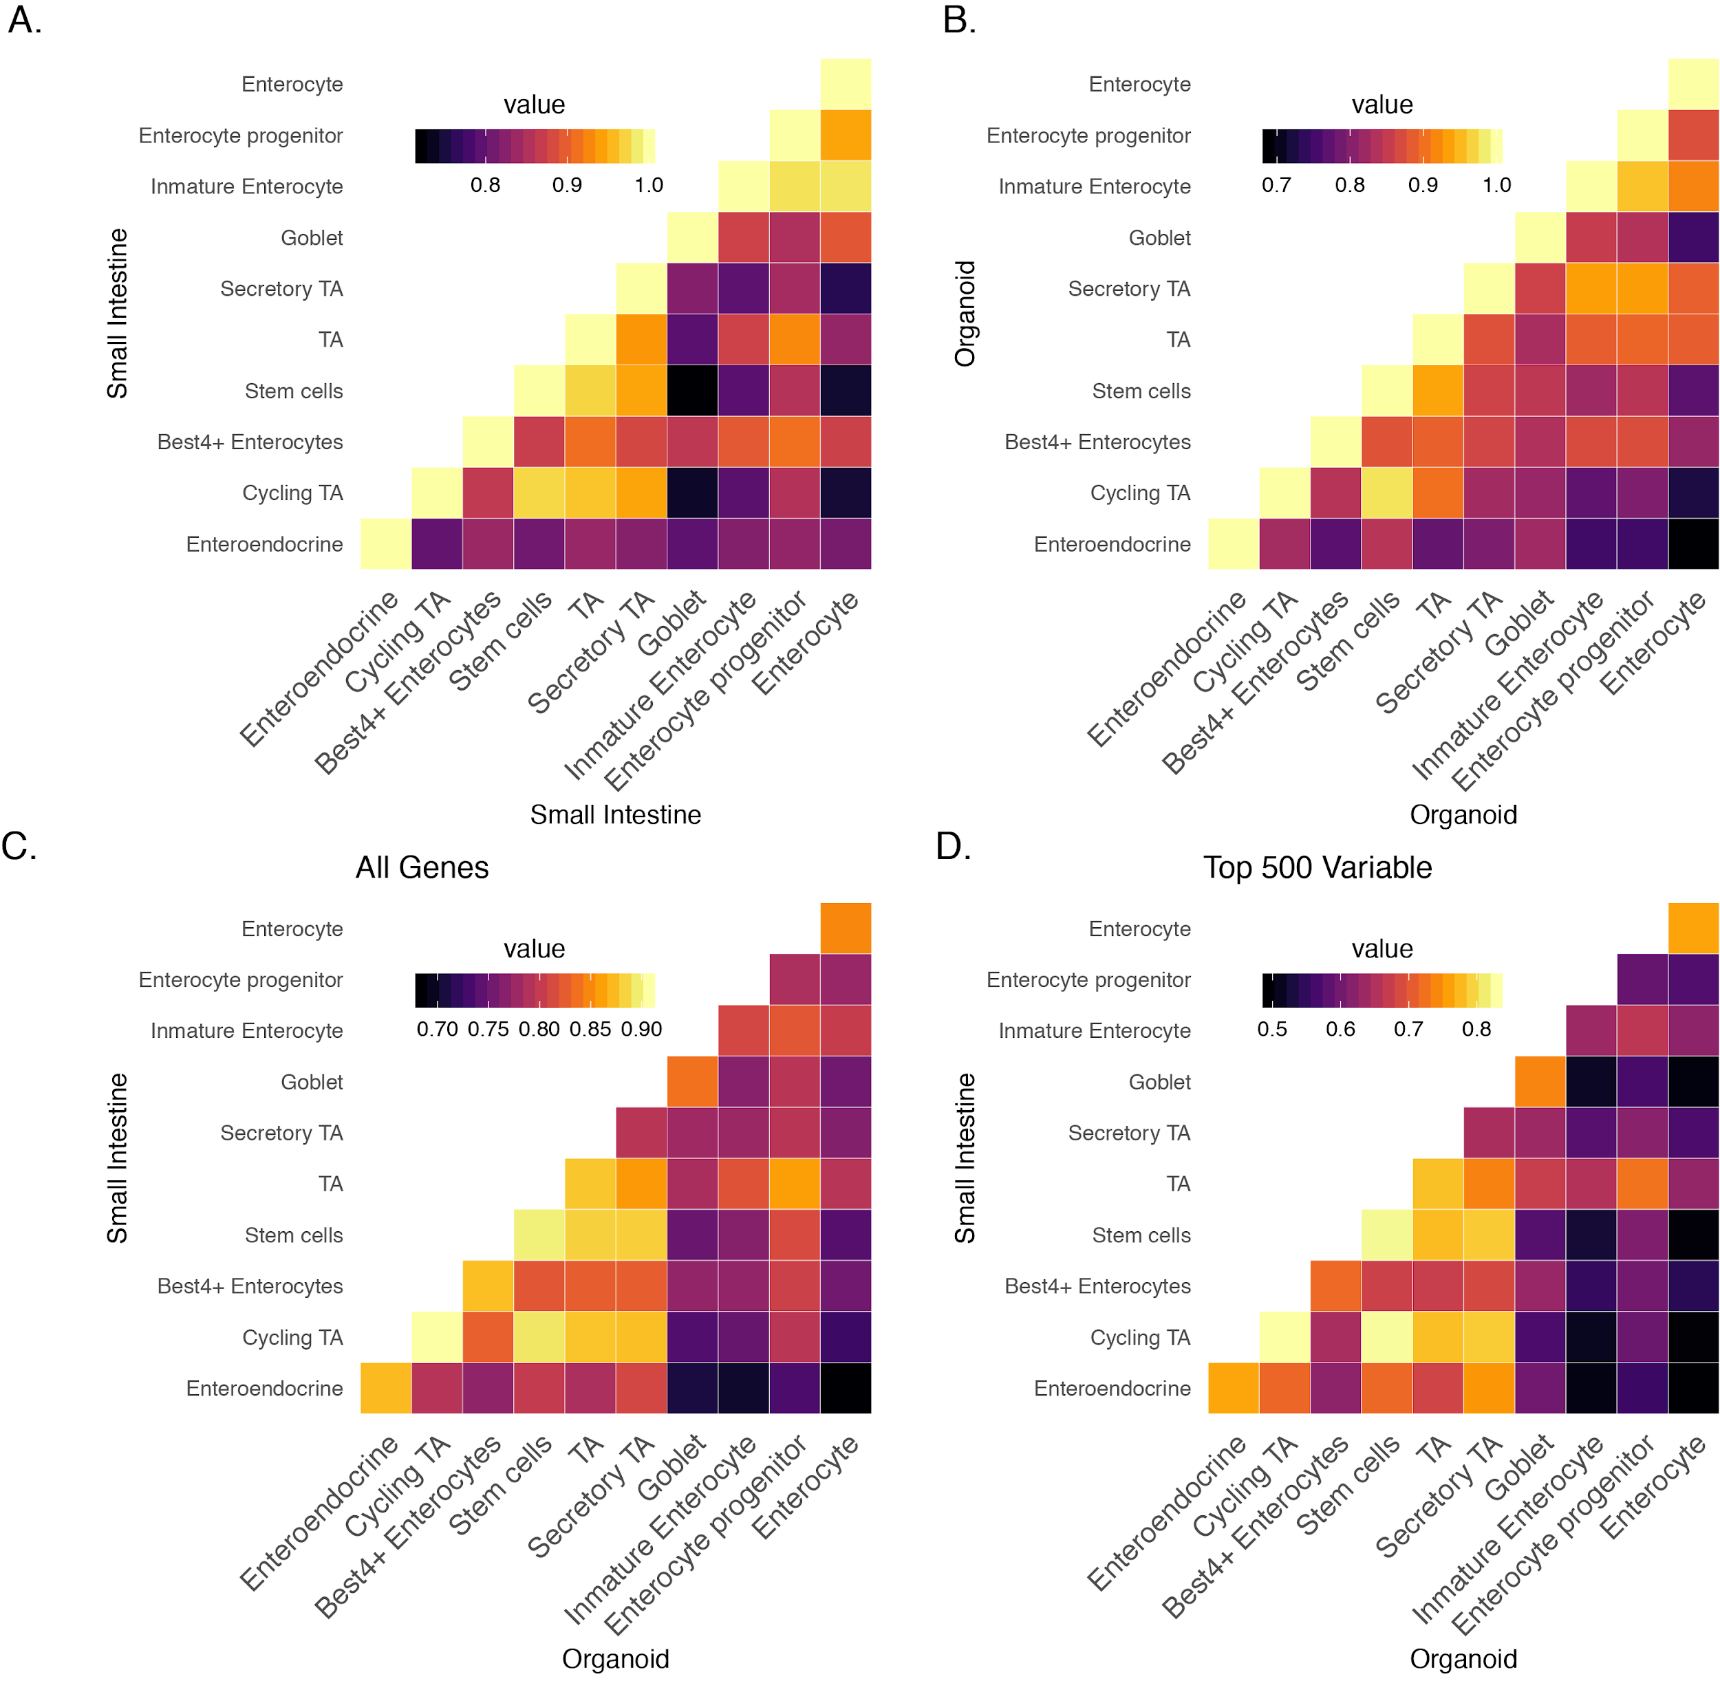
Example
Unsupervised clustering
Projected annotation from Smillie et al 2019
scMAP

Slide 56
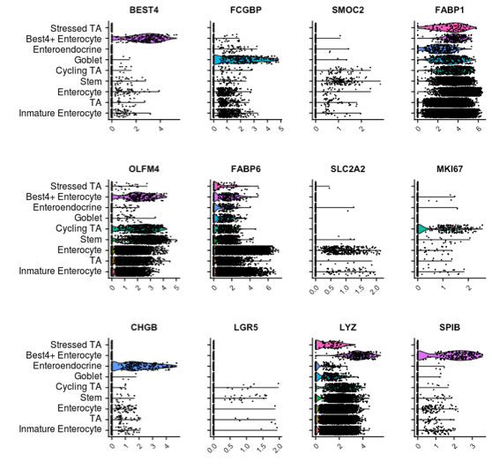
Example: validate with markers
B.

Slide 57
Example: validate with markers
B.

Slide 58
Example: annotate clusters

